Slide 1
Thesis Progress
Adaptive Equalization of Interchip communication
Dénis Silva
May 2014

Slide 2
MIPI physical Layer

Slide 3
Contents
This presentation demonstrates some results for the adaptation of the CTLE and DFE for the MPhy reference channels
Results for the CTLE adaptation using Assynchronous under-sampling-histograms
Results for the adaptation of the DFE using the LMS algorithm

Slide 4
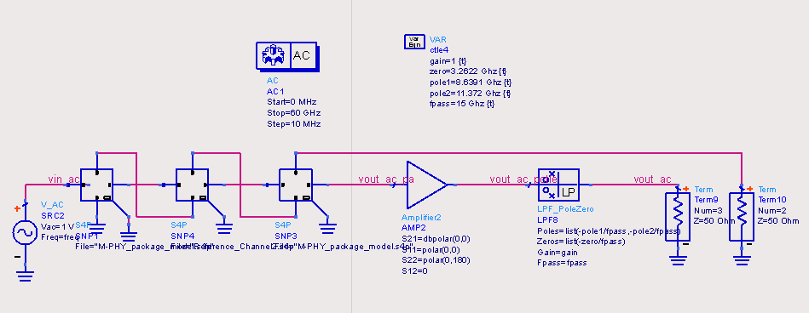
Channel characterization
Reference channels and package models represented in S-Parameters

Slide 5
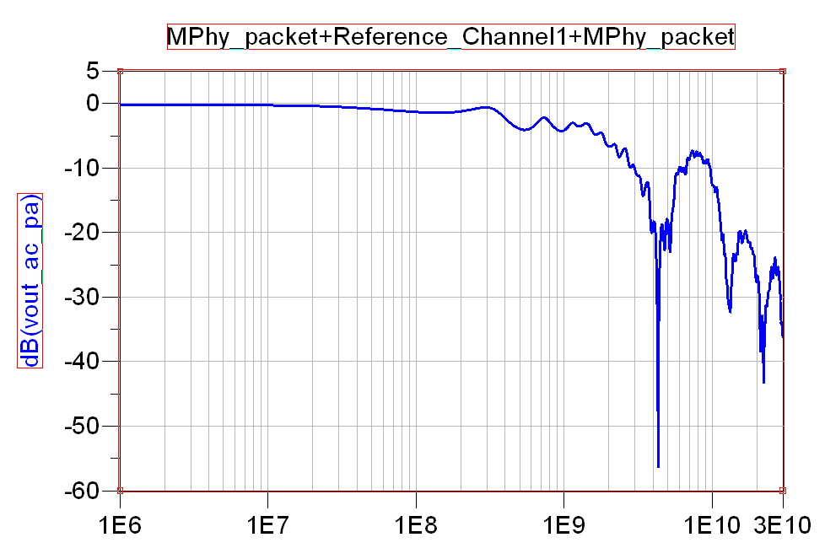
Reference channel1

Slide 6
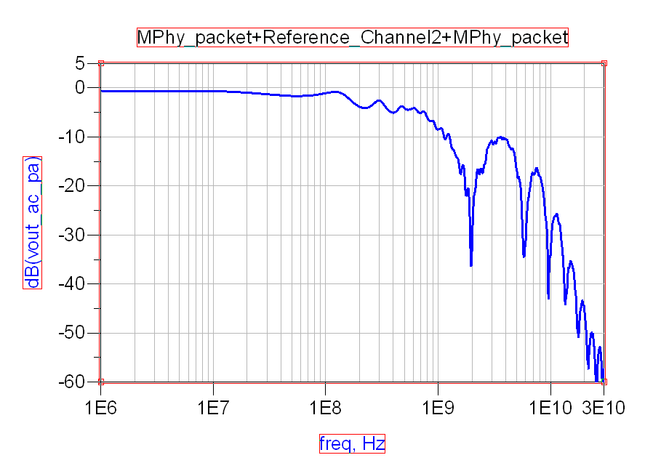
Reference channel 2

Slide 7
Eye Openign Diagrams
Tested eye opening diagrams for both Reference channels.
Simulation Parameters:
HS_G1_A :1.248 Gbits/s Vdiff=2V
HS_G2_B : 2.915Gbits/s Trise=Tfall=0.1UI
HS_G3_B :5.8304Gbs/s Maximum length PRBS with 8 Taps
HS_G4_B :11.66Gbs/s

Slide 8
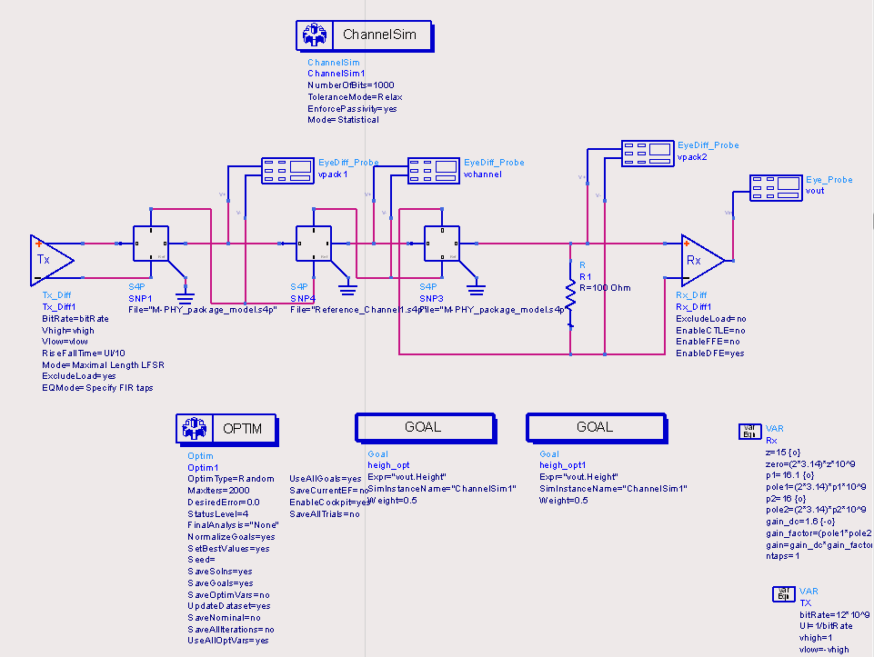
Simulation Settings

Slide 9
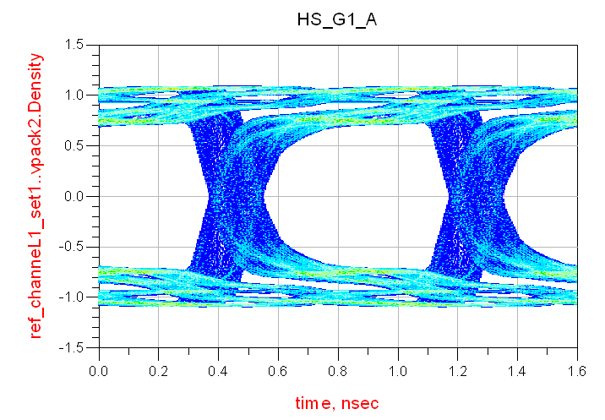
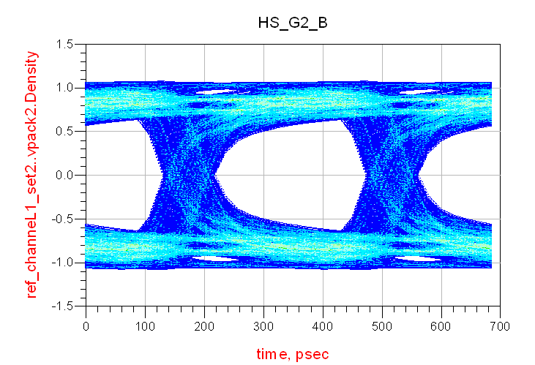
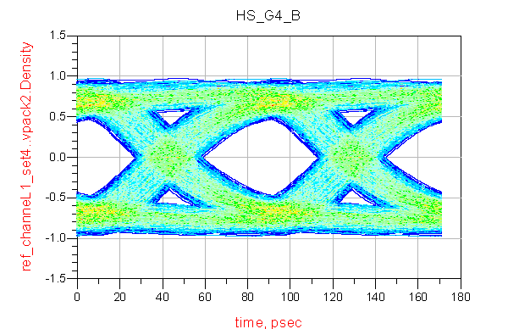
Eye Opening Diagrams Ref1

Slide 10
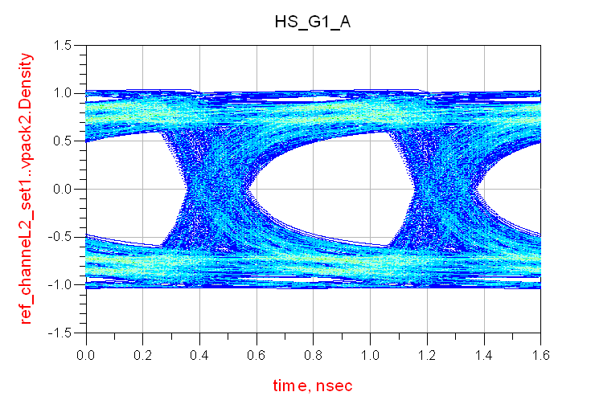
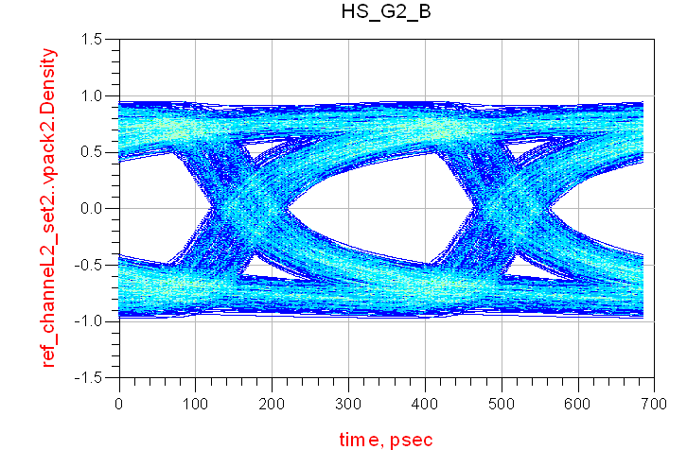
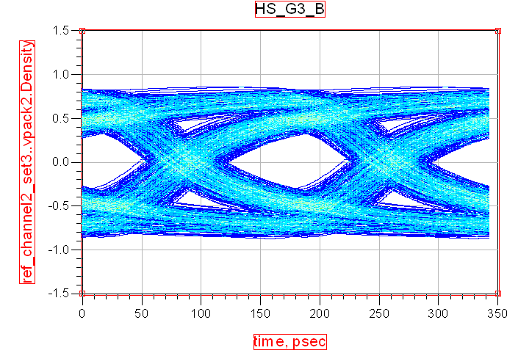
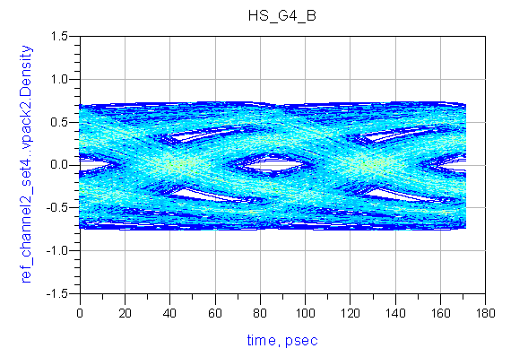
Eye Opening Diagrams Ref2

Slide 11
CTLE optimizer settings
The CTLE consists in a one zero , Two pole Transfer Function.
Optimize CTLE poles and zeros for maximum eye opening
1000bits/eye diagram calculation
Bit by bit simulation Mode
Random Optimizer
Maximize Eye Width and Height.

Slide 12
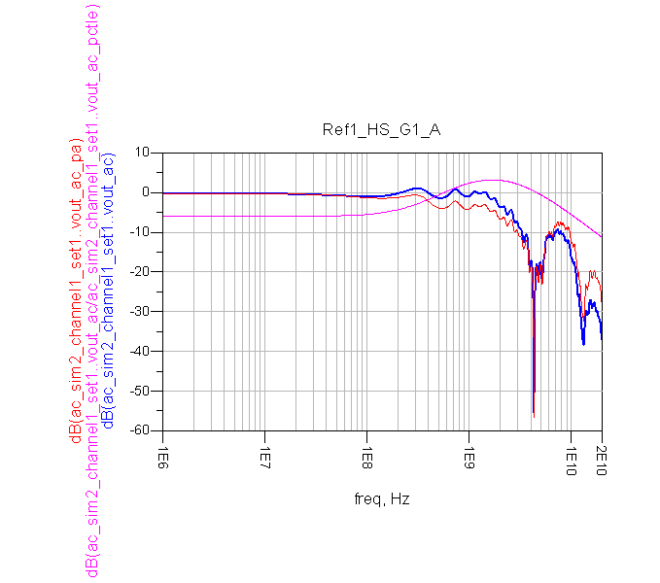
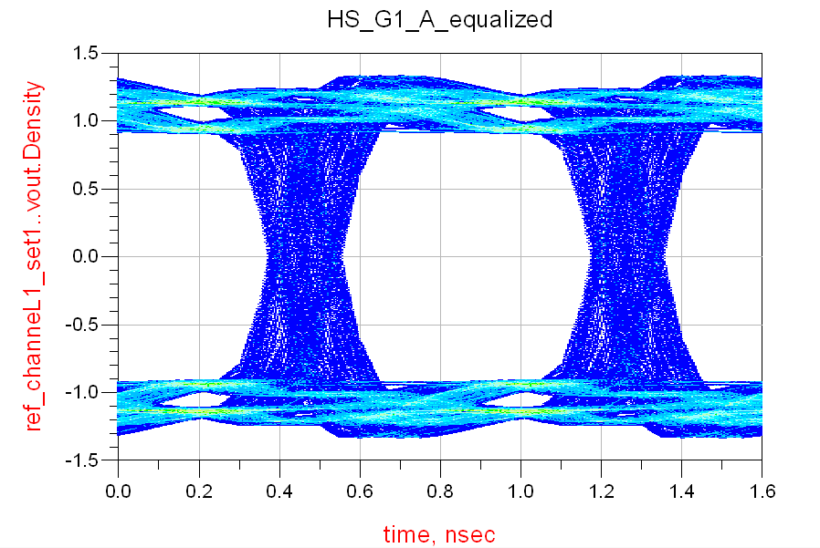
CTLE optimizer results Ref1 HS_G1_A
*Contains a correction to bring DC gain to 0dBc

Slide 13
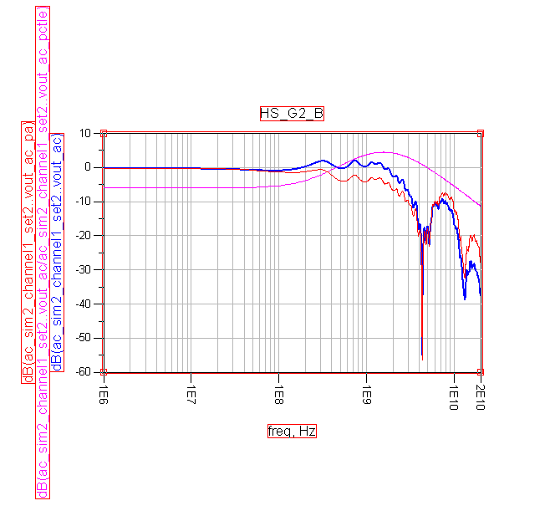
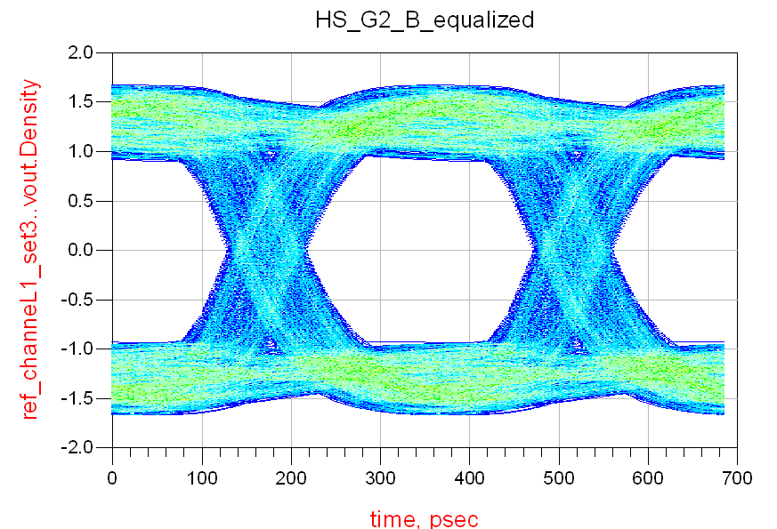
CTLE optimizer results Ref1 HS_G2_B
*Contains a correction to bring DC gain to 0dBc

Slide 14
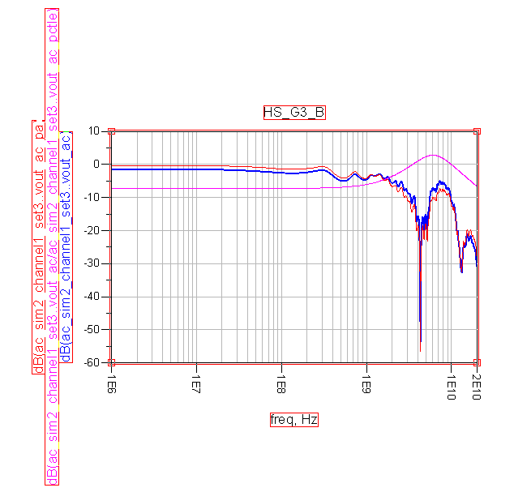
CTLE optimizer results Ref1 HS_G3_B
*Contains a correction to bring DC gain to 0dBc

Slide 15
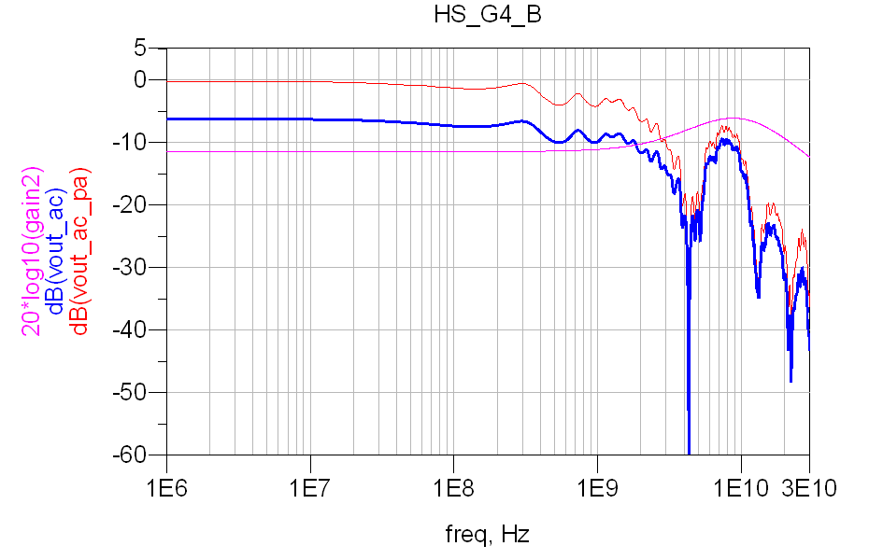
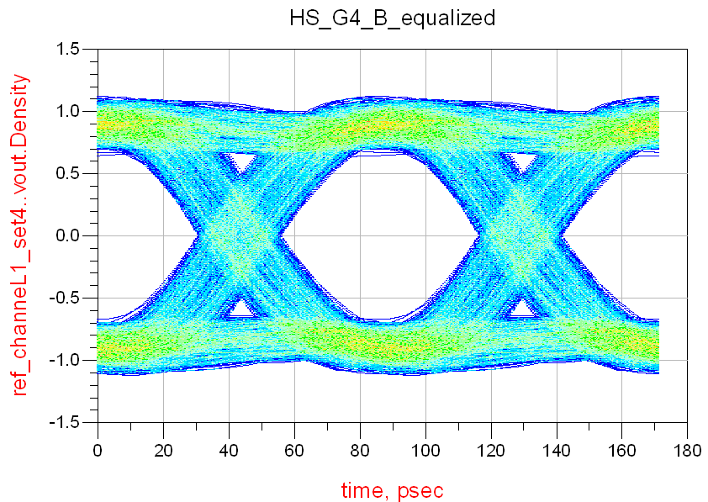
CTLE optimizer results Ref1 HS_G4_B
*Contains a correction to bring DC gain to 0dB

Slide 16
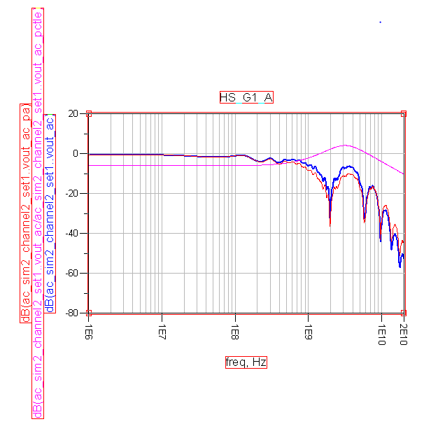
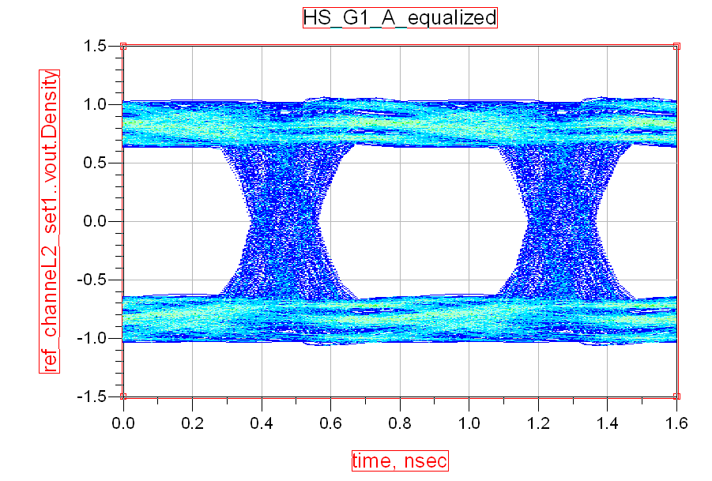
CTLE optimizer results Ref2 HS_G1_A
*Contains a correction to bring DC gain to 0dB

Slide 17
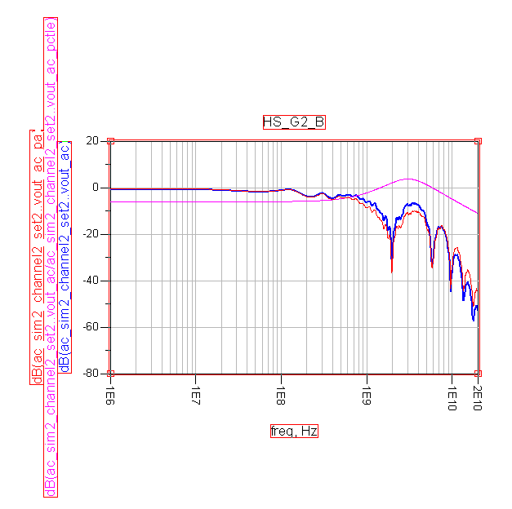
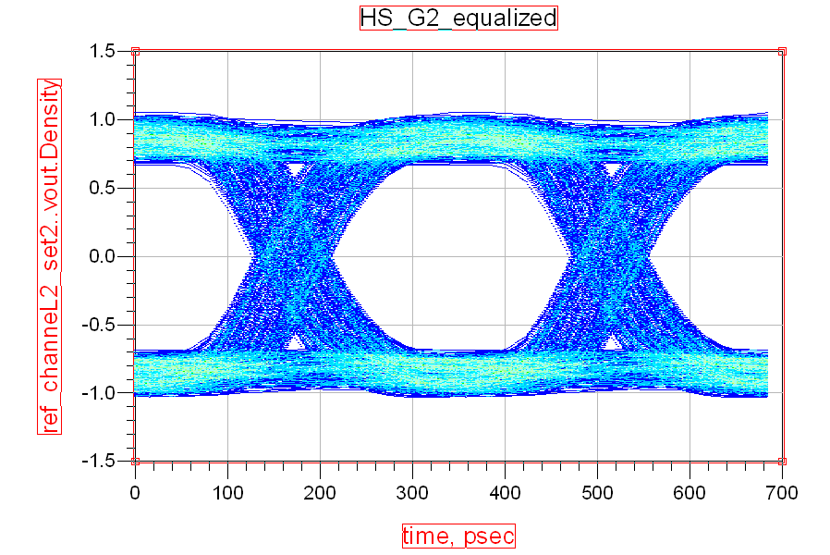
CTLE optimizer results Ref2 HS_G2_B
*Contains a correction to bring DC gain to 0dB

Slide 18
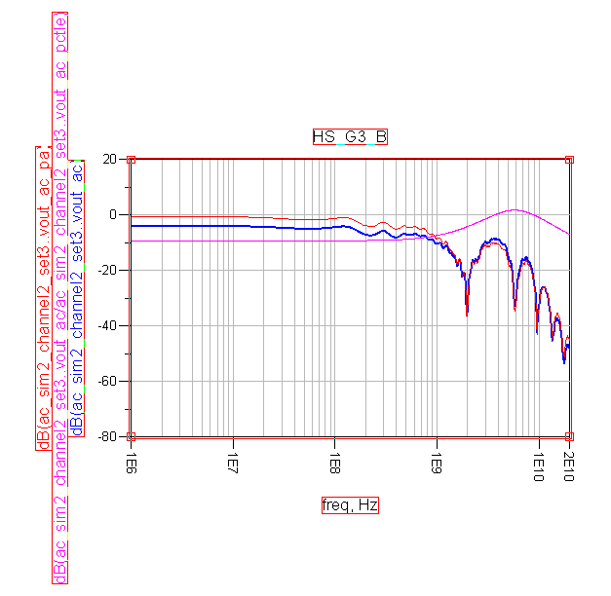
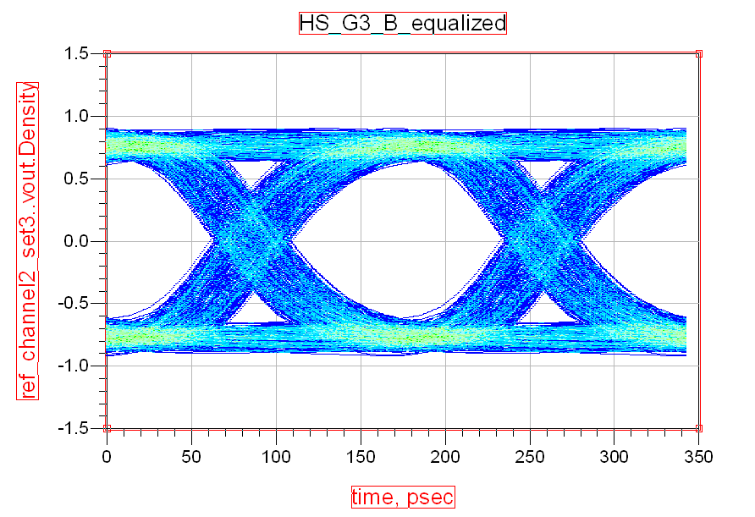
CTLE optimizer results Ref2 HS_G3_B
*Contains a correction to bring DC gain to 0dB

Slide 19
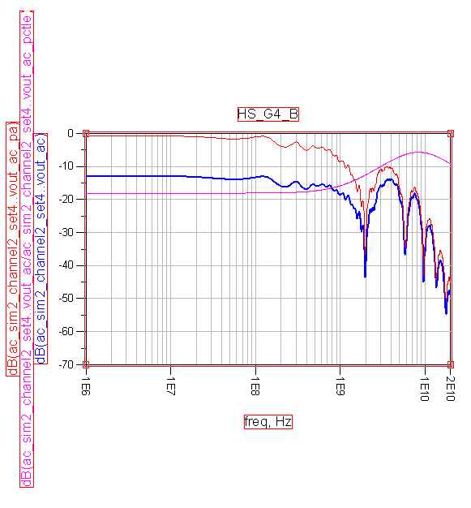
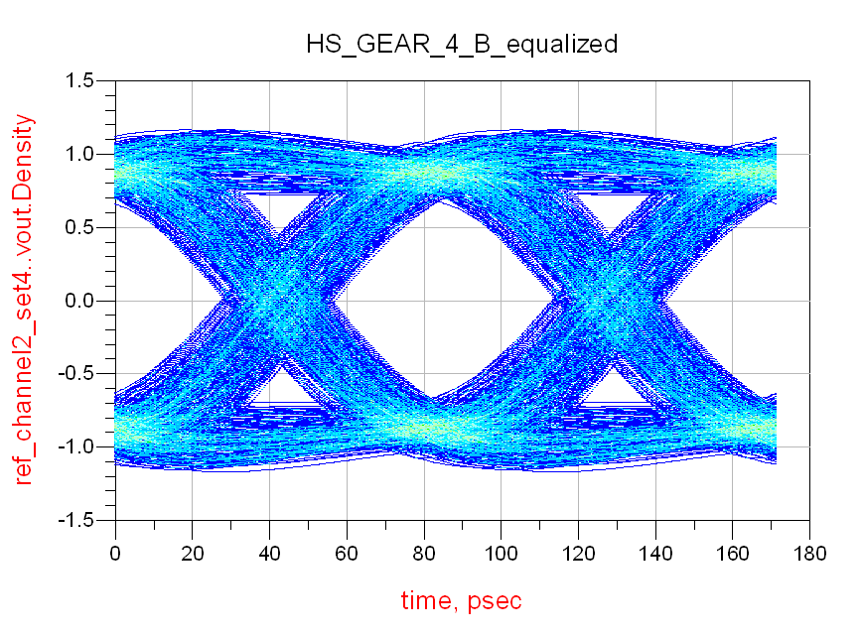
CTLE optimizer results Ref2 HS_G4_B

Slide 20
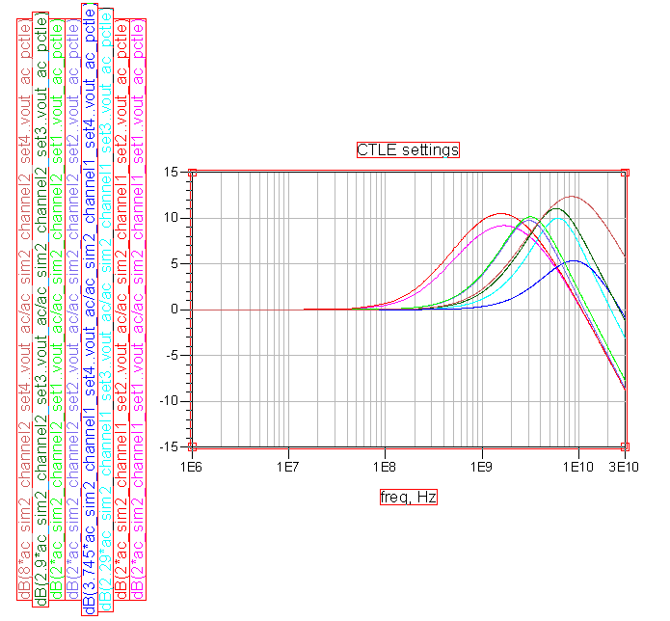
CTLE results

Slide 21
CTLE results
Position of the zero and the two poles of the CTLE
Gear Ghz | Ref.Channel1 Z P1 P2 |  |  |  | Ref.Channel2 Z P1 P2
HS_G1_A | 0.275 | 0.425 | 4.473 | set1 | 0.851 | 2.011 | 3.833 | set5
HS_G2_B | 0.234 | 0.435 | 3.253 | set2 | 0.880 | 1.974 | 3.823 | set6
HS_G3_B | 1.873 | 5.775 | 5.679 | set3 | 1.365 | 3.189 | 9.317 | set7
HS_G4_B | 3.262 | 8.639 | 11.37 | set4 | 1.193 | 5.659 | 12.85 | set8

Slide 22
CTLE adaptation
The CTLE will be adapted with assynchronous under-sampling histograms(the bigger peak in the received sample histogram results in the biggest eye opening).
The tests were made for reference channel 1
Bit Rate of 11.66Gbits/s
Bit by bit channel Simulation
3K bits Prbs9 sequence transmited
Over-sampling factor :16
To construct the histogram samples were selected in a time step (23/16)*UI

Slide 23
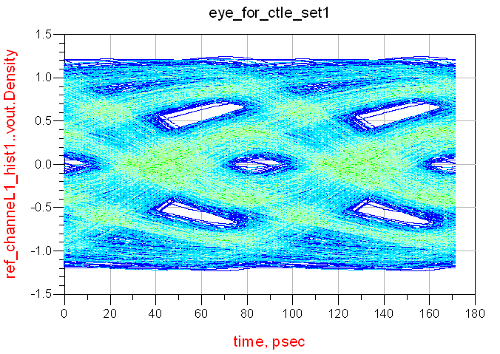
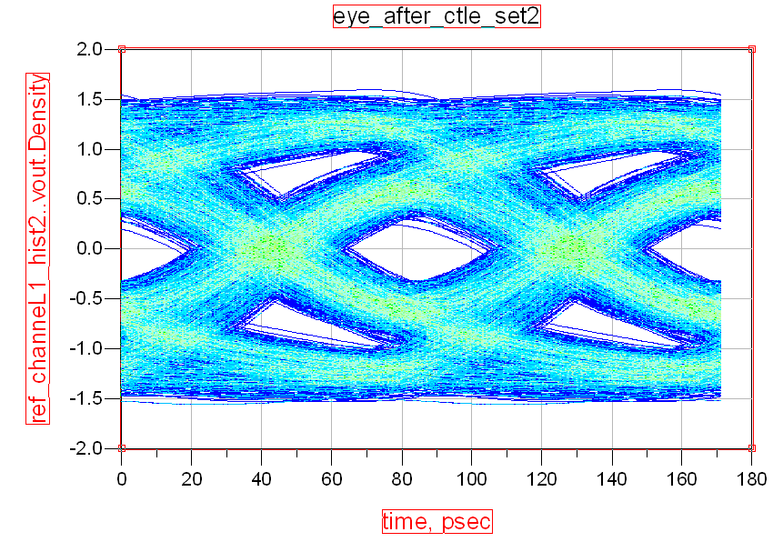
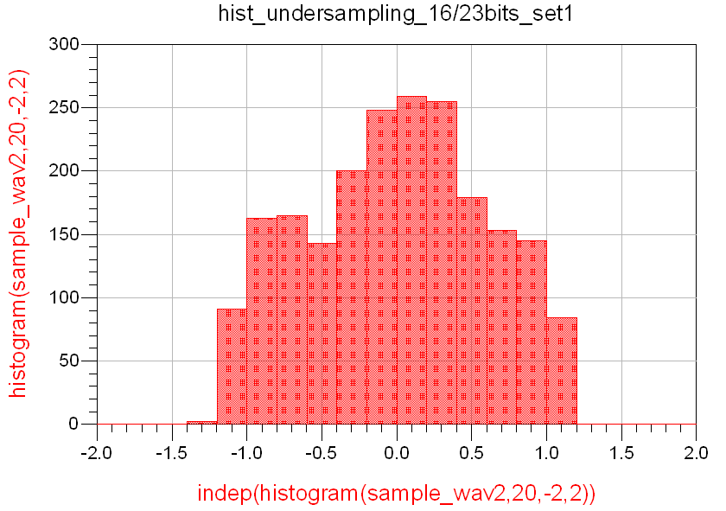
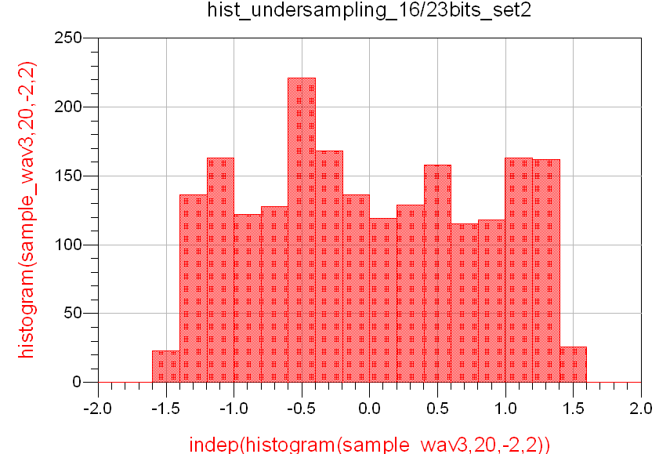
Eye vs histograms

Slide 24
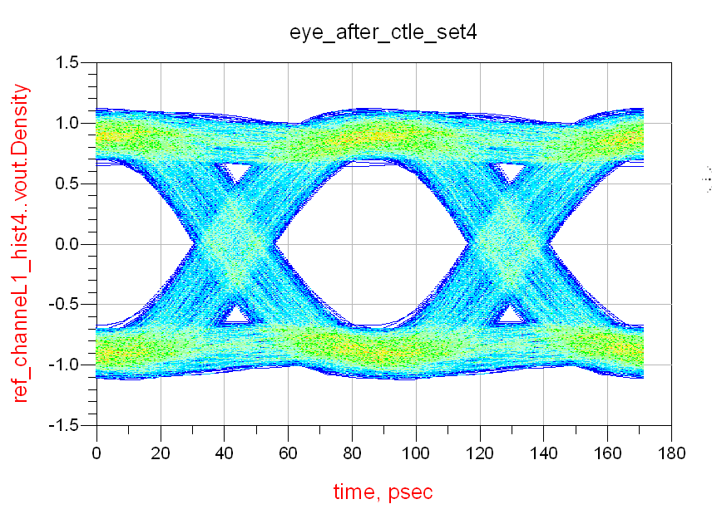
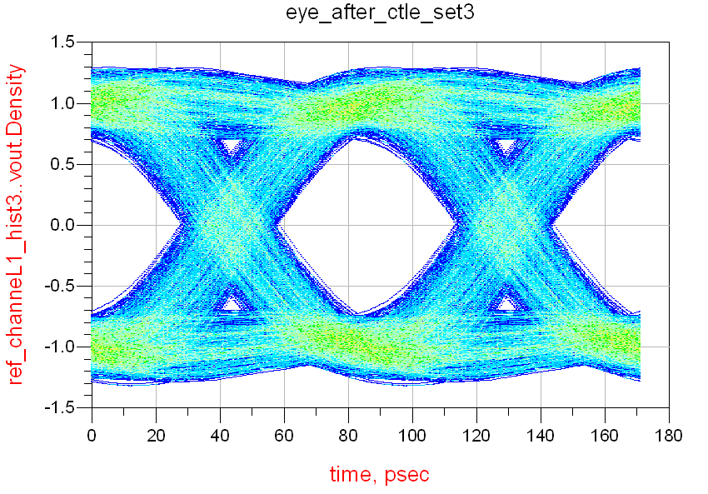
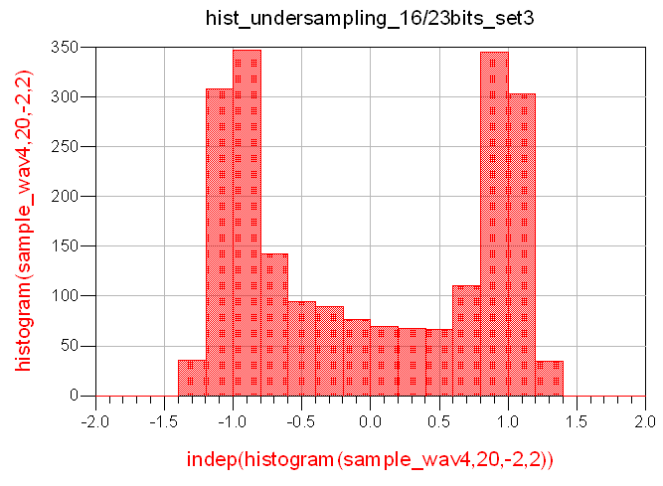
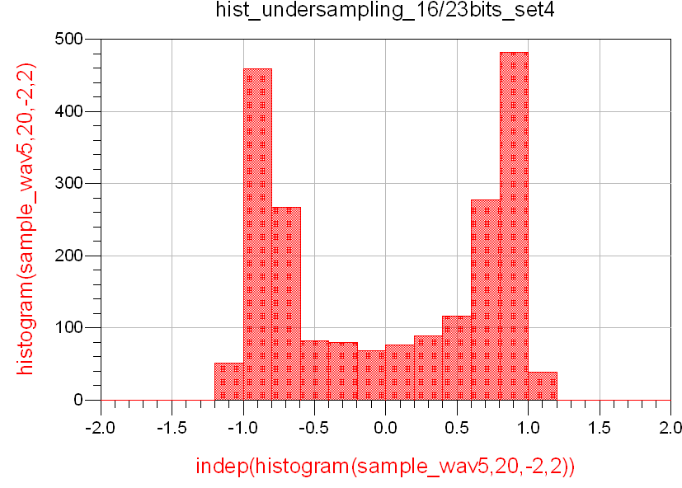
Eye vs histograms

Slide 25
Eye vs histograms
 | Before CTLE | Set1 | Set2 | Set3 | Set4
Level0 | 0.685 | 0.566 | 0.837 | 0.988 | 0.886
Level1 | -0.685 | -0.566 | -0.837 | -0.988 | -0.886
Height | 0.718 | 0 | 0.331 | 1.285 | 1.255
Width | 56.10ps | 13.72ps | 38.59ps | 59.18ps | 63.8ps
JitterPP | 29.59ps | 69.86ps | 46.81ps | 26.5ps | 21.87ps
JitterRms | 6.846ps | 13.97ps | 9.361ps | 6.204ps | 6.046ps
Hist_peak | 448 | 259 | 221 | 347 | 482
Selected_Setting

Slide 26
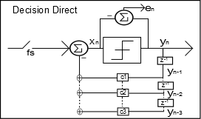
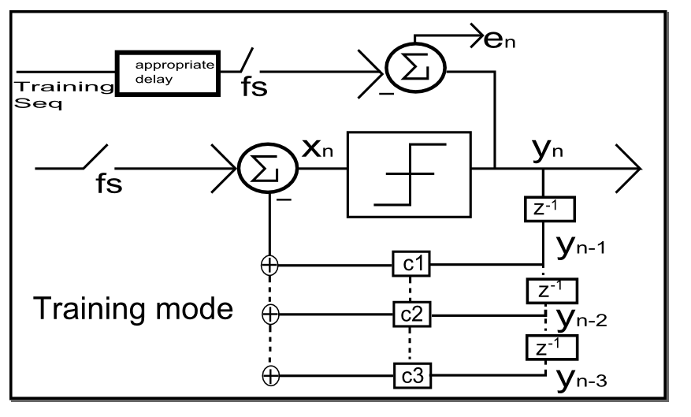
LMS Algorithm
The Lms algorithm tries to minimize the quadratic error e(n).
$$ck+1=ck −μ∗en∗yn$$
The error signal en can be calculated in training mode or in blind Mode(decision Direct).

Slide 27
LMS ALgorithm
Training mode
In the absence of errors Training mode takes a lot to converge
Consider for the error expression the input of the decision element:
$$en=dn−xn$$
Blind Mode
Blind mode has problems of converge if the number of wrong decisions is above a certain threshhold (typically >1%)

Slide 28
LMS Algorithm
The simulation was made with 5000 bits Generated by a maximum length PRBS generator.
1sample/bit Vin=+-1
Noise variance =0.001
Number of DFE taps=4
Decision Direct mode

Slide 29
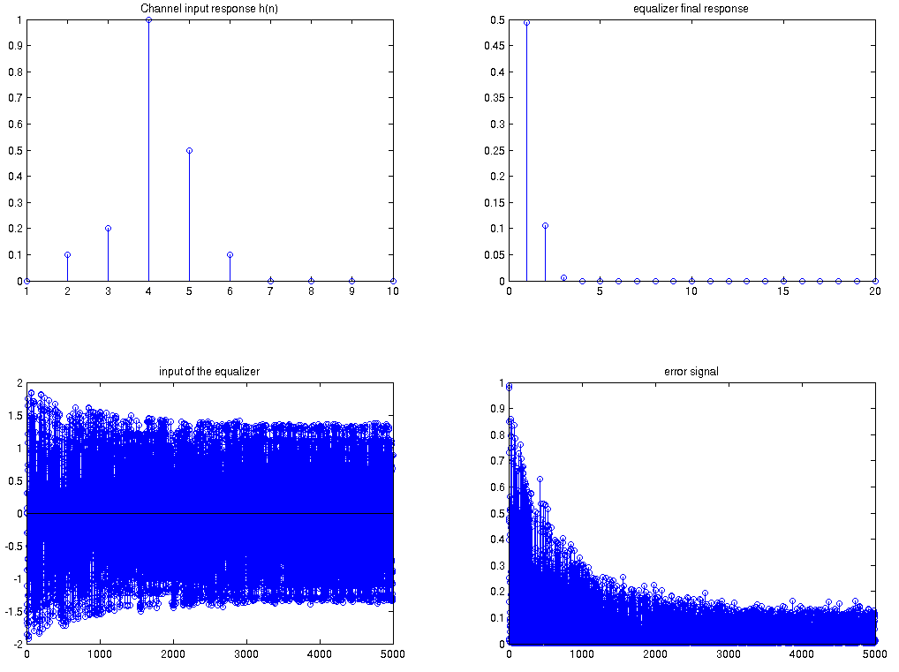
LMS Algorithm

Slide 30
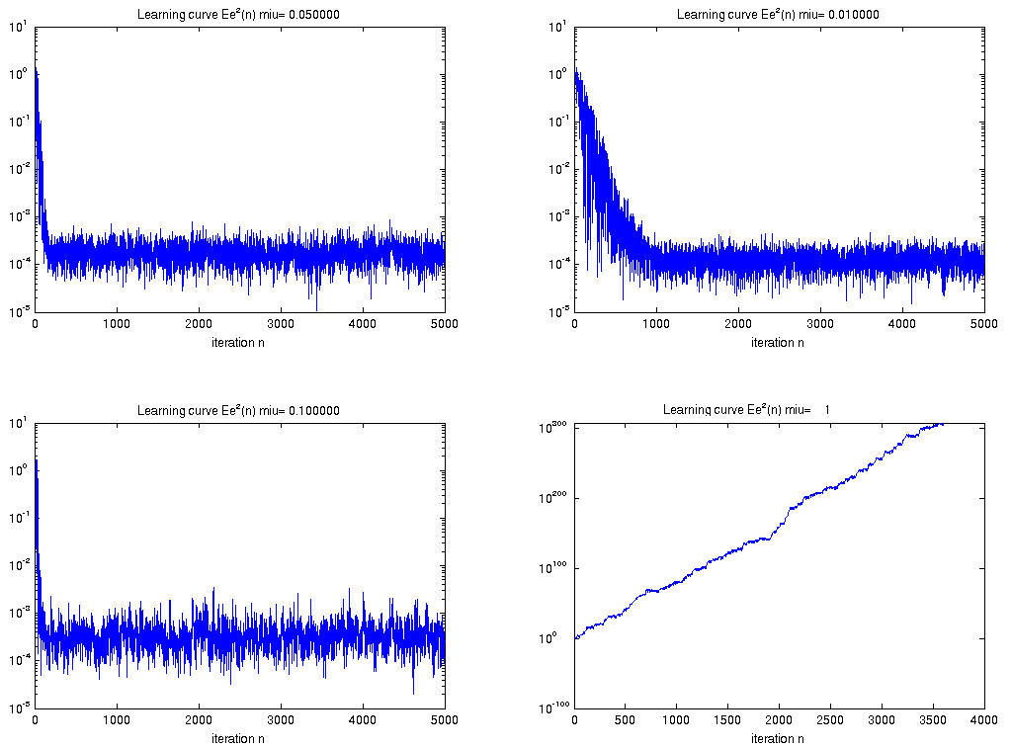
LMS Algorithm
Influence of the step size in DFE convergence speed

Slide 31
Spice modeling of the communication channel
Due to some problems with convergence in the ADS simulations continued in Hspice
Verilog A models were developed for the Receiver,CTLE,DFE,Data Slicers and the assynchronous Undersampling calculator block.
The Channel was described using a subcircuit in Hpice.

Slide 32
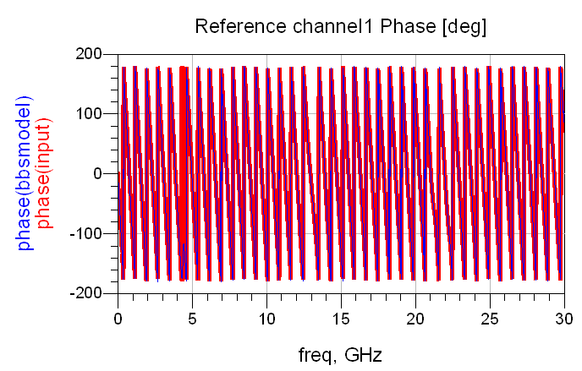
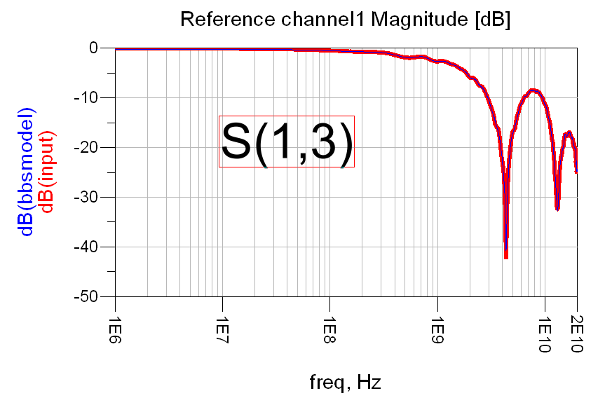
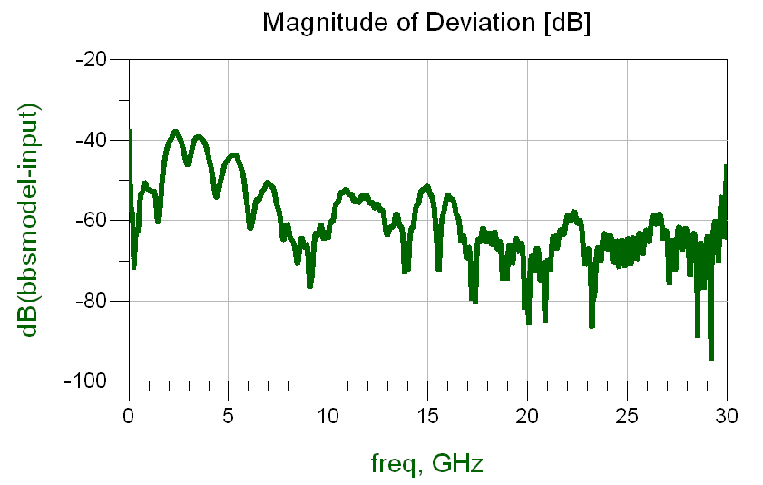
Spice modeling of the channels Ref1
S13 represents the insertion loss of pk1+ref_channel1+pk2

Slide 33
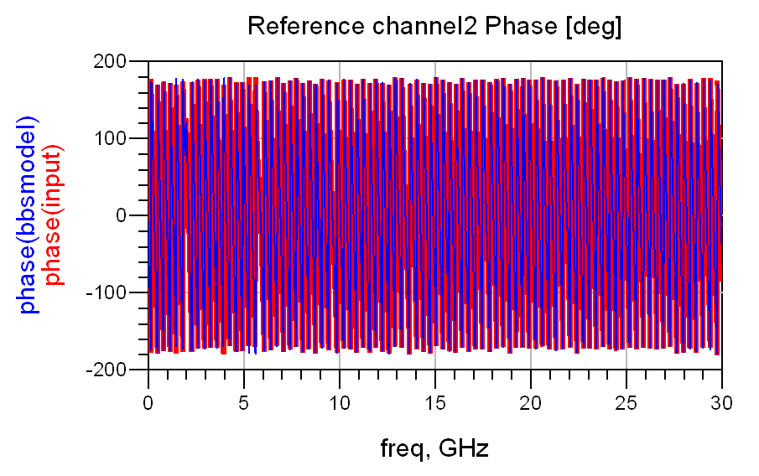
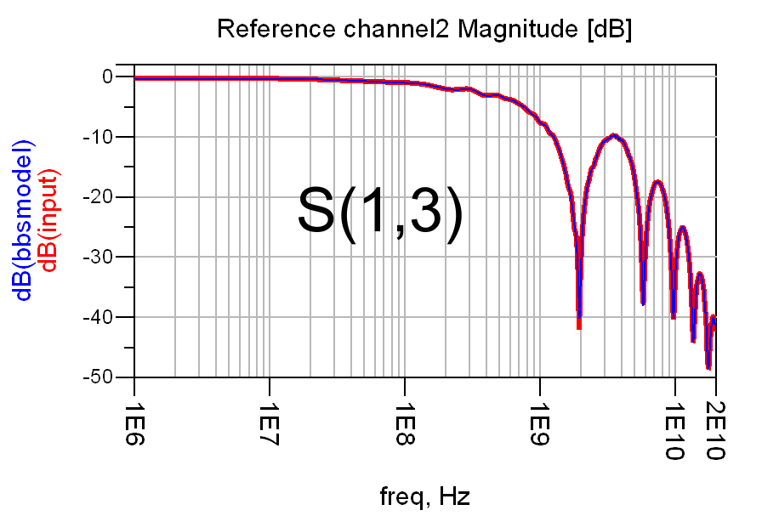
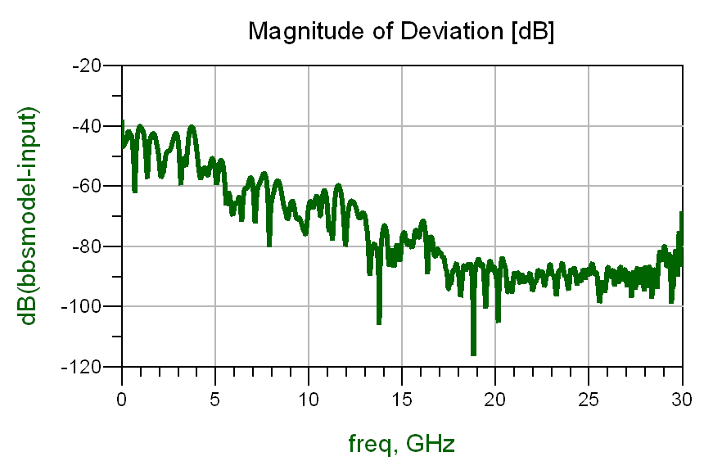
Spice modeling of the channels Ref2
S13 represents the insertion loss of pk1+ref_channel2+pk2

Slide 34
Spice simulations
Impulse response of both channels
Distortion introduced by the channels
Study of the CTLE
Ac simulation of the CTLE
Transient simulation of the efects of the CTLE in the bit sequence.
Transient simulation for the assynchronous histogram model
4. Convergence of The LMS algorithm with the use of diferent training sequences
Simulation of Blind and Training equalization Methods
5. Error correction for the 1,2 and 3 tap DFE

Slide 35
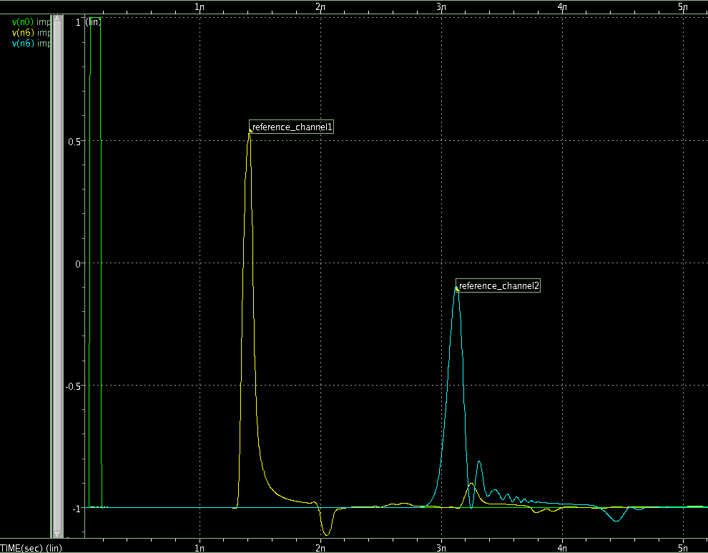
1-Spice simulation of the channels impulse response

Slide 36
Reference channel1/2
 | Ref.Channel1 | Ref.Channel1
Group Delay | 2.935ns | 1.273ns
Main Tap atenuation | ~25%(1.512/2) | ~55%(0.965/2)
1st post tap ISI | 0.22/1.5~0.14 | 0.21/0.965~0.21
2nd post tap ISI | 0.1/1.5~0.066 | 0.1658/0.965~0.16
3rd post tap ISI | 0.05/1.5~0.033 | 0.05/0.965~0.05
*Results obtained with spice command Measure.

Slide 37
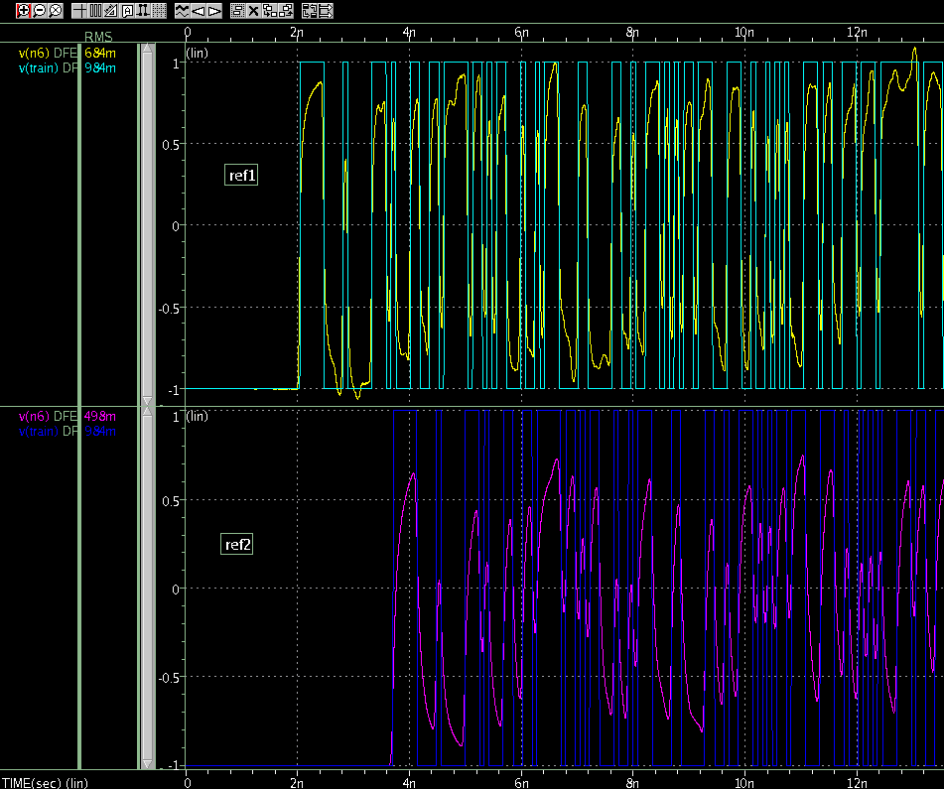
2-Reference channel1/2 Distortion
Critical decisions

Slide 38
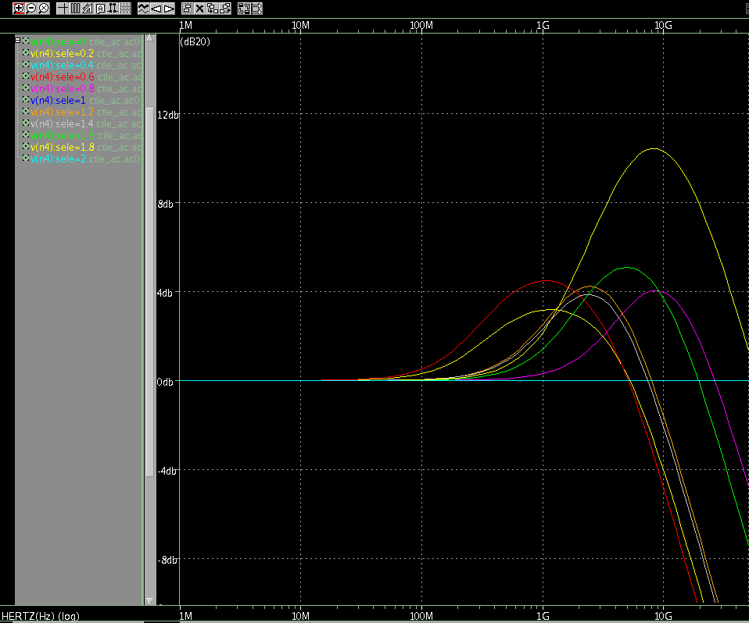
3.1.CTLE AC simulations in Spice
The frequency response of the verilog A CTLE model closely matchs the optimal value calculated in ADS

Slide 39
3. CTLE /histogram transient simulation
Specifics of the simulation
bitRate=11.66 Gb/s
Reference Channel1
Assynchronous clock = 2.3 slower than bitRate
Number of samples for histogram calculation=400
Time required for histogram calculation= Nsamples*clockPeriod ~59ns
Time required for CTLE adaptation=
Nsamples*clockPeriod*NumberOfSettings

Slide 40
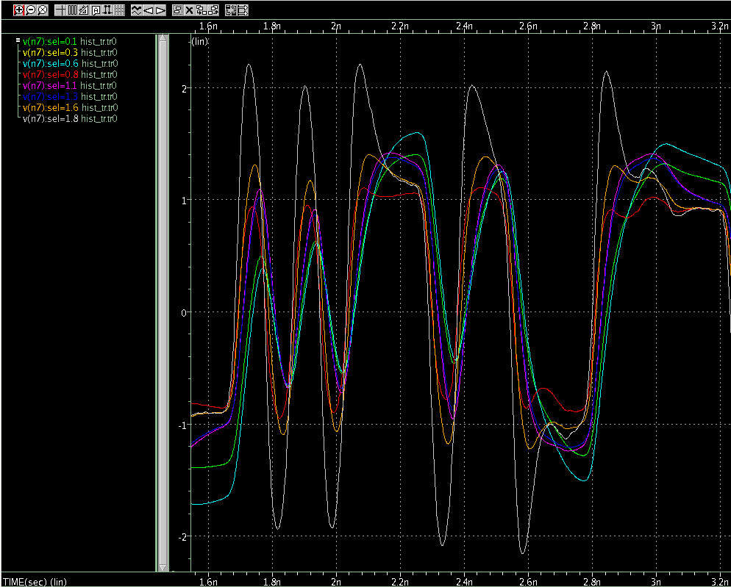
3.2 CTLE transient simulation
Over-equalization

Slide 41
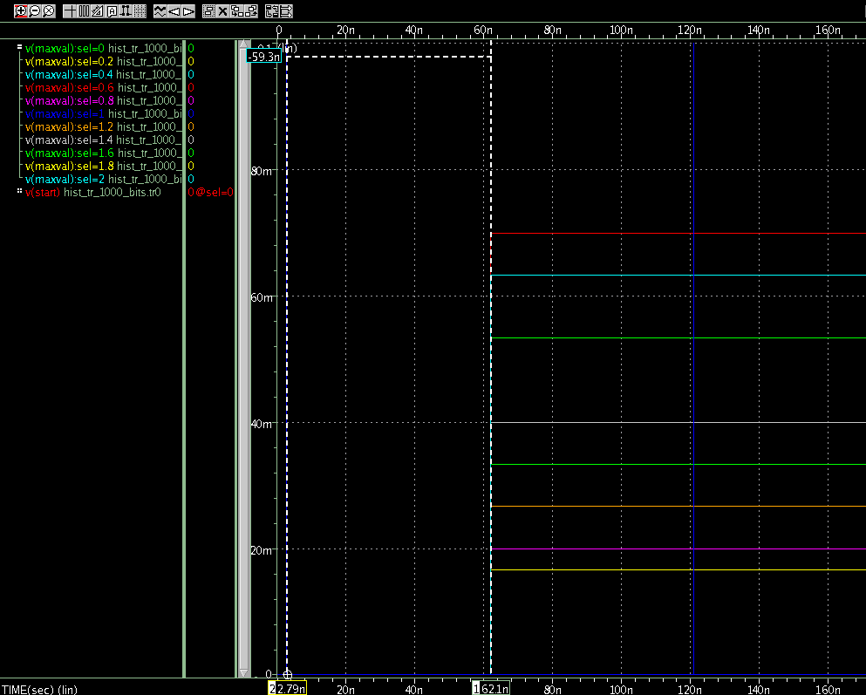
3.2 Histogram transient analysis
Selected setting

Slide 42
3.2 Histogram transient analysis
Variation of the histogram with the number of samples

Slide 43
DFE convergence reference channel1
Blind adaptation behaves the same way as training mode in the absence of decision errors.
The reference channel 2 introduces bit errors if the sequence of 1’s or 0’s is bigger than 4bits
In the absence of Noise a simple slicer would correctly recover the sent sequence in ref_channel1
 | Ref.Channel1 | Ref.Channel2
Group Delay | 1.273ns | 2.935ns
Main Tap atenuation | ~25%(1.512/2) | ~55%(0.965/2)
1st post tap ISI | 0.22/1.5~0.14 | 0.21/0.965~0.21
2nd post tap ISI | 0.1/1.5~0.066 | 0.1658/0.965~0.16
3rd post tap ISI | 0.05/1.5~0.033 | 0.05/0.965~0.05

Slide 44
DFE training Paterns

Slide 45
DFE blind convergence ref_channel2
Only PRBS converges to the correct value of the taps

Slide 46
4 .DFE convergence channel ref1
Step=0.0025

Slide 47
4.DFE convergence channel ref2
Step size=0.0025

Slide 48
DFE Simulations step size Prbs9
Tap evolution for step sizes = 0.0025 0.005 0.0075 0.01 0.0125
Reference_channel1

Slide 49
DFE Simulations sample jitter Prbs9
Simulation for jitter in the sample time = 'UI/10' 'UI/7.5' 'UI/5' 'UI/4‘
Reference_channel1

Slide 50
DFE Simulations Noise Simulations (training)
Vin=+-160mv | reference channel2 |11.66Gb/s

Slide 51
DFE Simulations Noise Simulations (training mode)
Vin=+-160mv | reference channel2 |11.66Gb/s

Slide 52
DFE Simulations Noise Simulations (blind mode)
Vin=+-160mv | reference channel2 |11.66Gb/s

Slide 53
5.DFE Simulations Error correction
To increase the ammount of errrors caused by the channel, introduced a second channel in series with the first one
Comparison between the errors correction of an ideal slicer and a 1,2 or 3 tap DFE.

Slide 54
5.1DFE Simulations Error correction

Slide 55
Conclusion
Use PRBS9 for the training sequence
In the absence of errors training mode and blind mode converge for the same values
The assynchronous under-sampling technique with a small number of samples is capable of making correct decision on the CTLE settings
The LMS shows good convergence characteristics even in the presence of jitter in the sample time.
To make more precise mearuments for the time required for adaptation some standarts must be defined.

Slide 56
Future Work ?
Test full system system with CTLE DFE and histogram.
Test circuit implementations for the CTLE
Simulate physical implementations of the DFE
3. Study the possibility of FIR Rx transversal equalizer
4. Study Tx FIR equalization and possible adaptation
5. Noise and Jitter measuremnts in training sequences
Simulate non ideal behaviour of the components of the system such as the slicers,CTLE ,DFE.
Implementation of the controller

